Slide 1
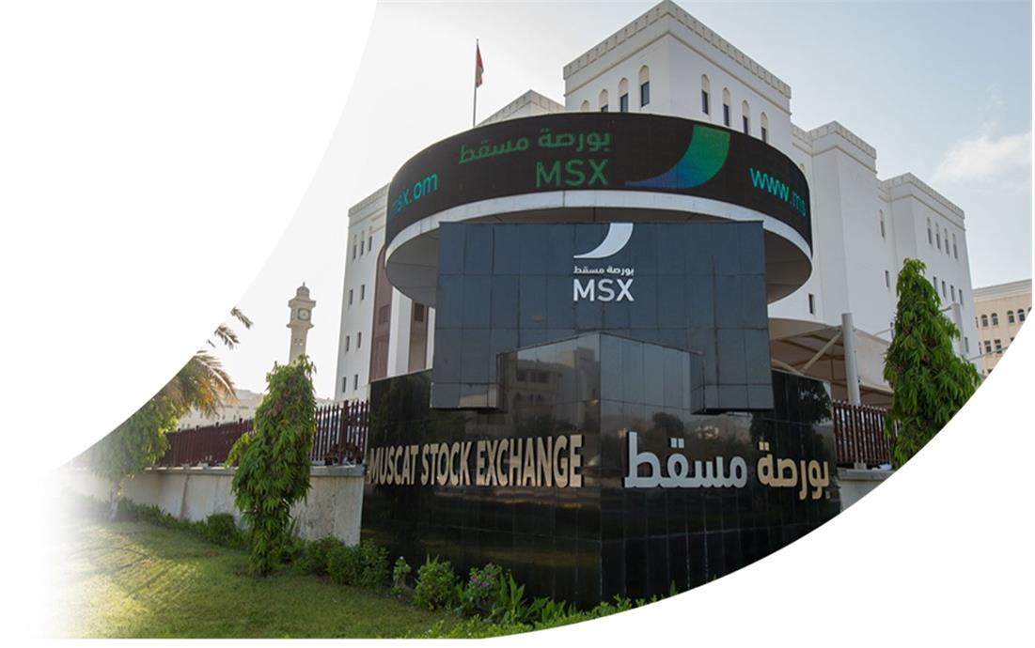

MSX Strategy
(2022-2026)

Slide 2





MSX Vision, Mission & 5 Year Strategy
National Economy Development
Efficient Market Infrastructure
Market Attractiveness & Access
Higher participation to GDP
SME Platform
Foreign Investments
Enhanced Market Operations & STPs
Disclosures
Market Indices
Regulations
Market Reclassification
Wider Products
Cheaper Access & Lower Investment Costs
Attractive Market
Professional Intermediaries
Vision
Slogan
Value
Leading Class Exchange with a Global Presence
“MSX the Exchange of Opportunities”
Trust
Competence
Innovation
Transparency
MSX Strategy (2022- 2026)
Sustainable Exchange
Futuristic Exchange
MSX Engine
Providing an efficient investment environment.
Operating in accordance with the best standards and practices.
Providing diverse opportunities that align with the goals of the national economy.
Commercial Operations
Efficient Resource Management
New Revenue Centers
Listing MSX Group
Compliance & Governance
Smart Exchange & Integrated Participants
Valuable Data (Big Data)
Digital Wallets
MSX Ambassadors
Employee Happiness & Satisfaction
Community Awareness & MSX Spots
Mission
Muscat Stock Exchange 2 www.msx.om

Slide 3
MSX Strategy Map
Gov. Entities
Liquidity Fund (LF) & Privatization Plan
Investors
Enhance Trading & Market Access
Issuers
Listing Incentives & Higher FDIs
Liquidity, Cap & Market Attractiveness
2022-2024
LF & Large Cap
Enhancing Liquidity & Enlarging Capitalization
FTSE/MSCI
Promotion to Emerging Markets List
Free Float
Adding Companies to Global Indices
EMERGING MARKET & FDIs
2024-2025
MSX Strategic Priorities
Products & Features
SLB, SS, ETF, Derivatives, Digital Assets, CCP.
Intermediaries
Strengthening Ties with Market Players
Market Players & Products
2025-2026
MSX SAOG
Listing MSX Group As a Public Company
GDP
Reflecting the Economy in MSX Performance
National Economy Development
2026
Muscat Stock Exchange 3 www.msx.om

Slide 4
Key Milestones
New Trading System (OPTIQ)
Market Making and Liquidity Providing
No Foreign ownership ceiling
Technical criteria to market upgrade
New Surveillance System (Kx)
Cross-Listing
ESG Practices
Regional Partnerships
Trade-at-Last Pricing Mechanism
Promoting MSX locally & Internationally
Linkage with Euroclear
MSX Group Synergies
Enhancements to the E-listing Platform
Sectorial Total Return Indices
Purification of Shariah-Compliant Companies
Risk Management
Muscat Stock Exchange 4 www.msx.om

Slide 5
Key Milestones
OPTIQ
MM & LP
FTSE
Technical Criteria
The new trading system has been successfully launched on Jan 2021
Features that support MSX Strategy
The legal framework has been prepared and submitted to CMA for approval
MM activity requests have been received and are being reviewed
Removal of Foreign Ownership Limits for All listed Securities (April,22)
Continuous tracking of liquidity position
State owned entities privatization plan to enhance liquidity
Kx
Cross-Listing
ESG
Partnerships
A new surveillance system has been launched to enhance surveillance procedures and boost market confidence
Cooperating with Tadawul to initiate the project
Several meeting with Omani listed companies to promote the project
Preparation of technical links and legal framework
ESG & DI Division has been established
Partnership with UN SSE Initiative
Joining a GCC committee to prepare ESG unified criteria
Adapting the internal environment to comply with ESG practices
Signing an MOU with Tadawul group
Signing an MOU with Iraq Stock Exchange
Initiation of Collaborations with ADX and Bahrain Bourse (BHB)
TAL
Marketing
Euroclear
Synergies
Changing the pricing mechanism from VWAP to TAL to enhance fairness and integrity in pricing
May 2022
Conducted a marketing campaign targeting international fund managers
Activated social media platforms to boost investment awareness
Opened an account with Euroclear to facilitate international investors access to the market
Merging the support functions to enhance operational efficiency and reduce costs
E-listing Platform
TR Indices
Purification Rates
Risk & Compliance
Listing workflow has been updated to incorporate CMA
Facilitated listing applications’ procedures
3 Total return indices have been launched for industrial, financial, and services sectors to meet investors needs.
Signed an Agreement with Ideal Rating to provide the list of complaint companies along with purification percentages
Establishment of a Compliance and Risk Management Department to ensure compliance with international best practices and achieve sustainability
Muscat Stock Exchange 5 www.msx.om

Slide 6

Thank you!
MSX Contact Details:
P.O Box: 3265 Postal Code: 112, Ruwi Sultanate of Oman
Phone: +96824823600
Fax: +96824823706
Email: info@msx.om
Website: www.msx.om
Muscat Stock Exchange 6 www.msx.om

